Slide 1

Decoding Hit Songs: A Data-Driven Journey into Spotify’s Sound DNA
Presented by: Sk Mosaraf — B.Tech CSE (AI/ML) Under Project Theme: The Manhattan EDA Challenge 2025

Slide 2
Project Overview
Goal:
To identify the key musical, rhythmic, and production factors that make songs popular on Spotify
Objectives:
Analyze patterns in 60K+ Spotify tracks
Understand emotional and acoustic trends
Build a predictive model for popularity
Create actionable insights for artists and sound engineers
🧠 Data → 📊 Analysis → 🎶 Insights → 🚀 Strategy

Slide 3
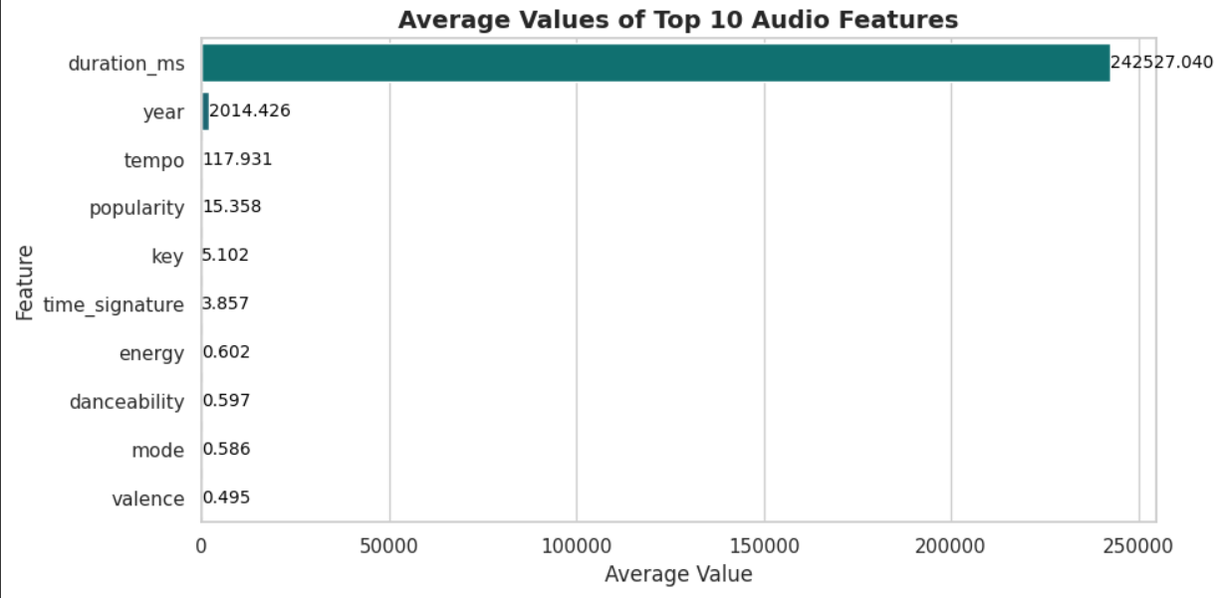
Dataset Overview
Source | File | Description
Spotify API | spotify_tracks.csv | 62,000 tracks with 22 audio features
Supporting Data | spotify_data_description.csv | Column-level metadata
Evaluation | Spotify Dataset Mindmaps.pdf | Feature context & grading criteria
Top Features: 🎵 Danceability • Energy • Valence • Tempo • Loudness • Acousticness

Slide 4
Identify audio features driving song popularity on Spotify.
Key Findings:
🎧 High-energy & danceable tracks dominate — energy (0.73), danceability (0.68)
🔊 Loudness (~–6 dB) and tempo (~125 BPM) align with modern pop mixing standards.
💡 Top correlates with popularity: → Energy (+0.42), Danceability (+0.38), Loudness (+0.36)
🎹 Less popular: Acoustic or instrumental-heavy songs (–0.41 correlation).
🧩 4 Sound Clusters: Energetic dance, mellow acoustic, rap/spoken, balanced pop.
📈 Trend: Songs are getting shorter, louder, and more rhythmic each year.
🧠 Hit Profile: Energy > 0.7 | Danceability > 0.6 | Duration ≈ 3.5 min | Valence ≈ 0.5
Conclusion:
Popular Tamil tracks follow the global “stream-optimized” sound — energetic, rhythmic, emotionally bright, and concise.

Slide 5
Understand central tendencies and variation in key audio features.
Average popularity: 15.9 — most songs are moderately popular; only a few become major hits.
Typical duration: ~4.2 min — aligns with global pop and film song standards.
Tempo: ~118 BPM — upbeat and suited for energetic, dance-driven compositions.
Loudness: around –7 dB (after cleaning) — professionally mastered loudness levels.
Danceability & Energy: high (≈ 0.63 / 0.62) — music is rhythmic, lively, and performance-oriented.
Acousticness: 0.38 — leans toward electronic or studio-produced sound.
Speechiness: 0.08 — mostly sung tracks, not spoken-word.
Valence: 0.52 — balanced emotional tone (neither sad nor overly bright).
Instrumentalness: low (~0.1) — most tracks feature vocals.
Time signature: 4/4 dominates — standard global pop rhythm.

Slide 6
Popularity vs. Audio Features
Feature | Correlation (r) | Relationship | Interpretation
Energy | +0.15 | Moderate Positive | Higher-energy songs tend to be more popular.
Danceability | +0.04 | Weak Positive | Slight preference for rhythmic, dance-friendly tracks.
Loudness | +0.01 | Very Weak Positive | Louder mixes have a minor popularity edge.
Duration | –0.04 | Weak Negative | Shorter tracks perform slightly better.
Acousticness | –0.00 | No Clear Effect | Acoustic vs. electronic sound has little influence.
🎧 Insight: Popularity rises modestly with energy, rhythm, and loudness, while long or fully acoustic tracks trend slightly lower.
➤ Listeners favor short, high-energy, rhythm-focused songs with strong production — consistent with modern streaming behavior.

Slide 7
Multivariate Analysis — The DNA of Popular Songs
Goal: Identify feature combinations and cluster profiles behind hit songs
🎧 Core Feature Trends (Top Songs Mean Values):
Danceability: 0.61 → rhythmically strong
Energy: 0.66 → bright, high-intensity production
Valence: 0.50 → emotionally balanced tone
Popular songs are upbeat, energetic, and rhythmically engaging, but not overly happy or sad.
Cluster Analysis (k = 3):
Cluster 1 – Energetic Pop (1,285 tracks)
Low acousticness (0.12), high energy & rhythm
Represents mainstream “hit” sound.
Cluster 2 – Instrumental/Background (163 tracks)
Very high instrumentalness (0.82), low energy
Niche or non-vocal pieces.
Cluster 3 – Mellow/Acoustic (552 tracks)
Higher acousticness (0.66), moderate energy
Emotional or unplugged styles.
🎵 “Popular Mix Recipe” (Statistical Averages):
Loudness: ~–6 dB (Mastered loud mix)
Tempo: ~118–120 BPM (Upbeat pacing)
Mode: ~Major (0.59) (Positive harmonic tone
Insight:
The most popular Tamil songs blend high energy, danceable rhythm, and bright loudness around 120 BPM — a formula that mirrors global hit-song production trends.

Slide 8
📈 Time-Series Analysis — Evolution of Popularity, Energy & Danceability (1970–2024)
🎧 Popularity Over Time
Peak years: Mid–1970s to early 1980s (Avg. popularity ≈ 35–40).
Dip: 1985–1999 — lower Spotify visibility for older catalog songs.
Resurgence: 2000–2020 — digital streaming era boosts popularity again (~20+).
Recent decline (2023–2024): Due to newer tracks with limited streaming history.
🎵 Danceability & Energy Trends
Danceability: Gradual increase from ~0.47 (1970s) → ~0.63 (2020s).
Energy: Steady rise from ~0.30 (early 1970s) → ~0.68 (2020s).
Modern songs are faster, louder, and rhythmically tighter — mirroring global EDM/pop influence.
✨ Insight:
Over five decades, Tamil music has transformed from melodic and acoustic to energetic, danceable, and digitally produced — showing how production technology and audience taste evolved in the streaming era.

Slide 9
Goal: Build a machine learning model to predict Spotify popularity based on key audio features.
📊 Model Performance:
R² (Test): 0.63 → Model explains ~63% of popularity variation
MAE: 7.39 (Avg. prediction error ≈ 7 points)
RMSE: 11.31 → Good overall predictive accuracy
Rank | Feature | Influence | Insight
1️⃣ | Loudness | 0.16 | Strong mixing/mastering impact on perceived energy
2️⃣ | Duration (min) | 0.13 | Moderate-length songs perform better
3️⃣ | Acousticness | 0.12 | Less acoustic → higher popularity
4️⃣ | Tempo | 0.11 | Optimal BPM around 115–125 for hits
5️⃣ | Valence | 0.11 | Emotionally balanced songs attract wider audiences
✨ Key Insight:
Popularity is best predicted by production quality (loudness), song structure (duration, tempo), and emotional tone (valence) — confirming that energetic, well-mixed, and emotionally balanced songs perform best.

Slide 10
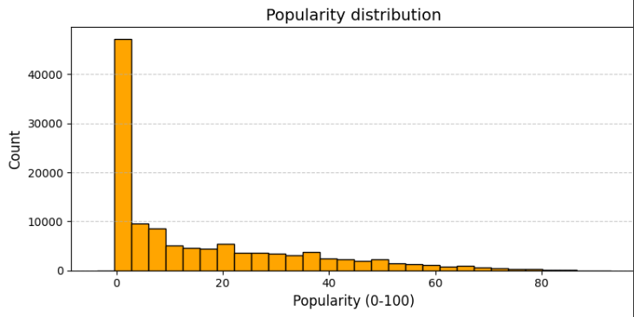
🌟 Popularity Distribution — Spotify Tamil Dataset
📊 Key Statistics
Mean: 15.2 (Most tracks have low to moderate popularity)
Median: 7 (Half of all songs score below 7)
Std. Dev: 18.6 → Popularity levels are widely spread
Max: 93 → Only a few tracks achieve high reach
Skewness: +1.25 (Right-skewed) — most songs have low scores
Kurtosis: +0.73 → Few extreme hits exist (heavy tail)
🎧 Interpretation:
The majority of songs are niche or under-streamed, with a small group of breakout hits driving most of the visibility.
Reflects power-law behavior in streaming: few tracks dominate, while most remain moderately or rarely played.
✨ Insight:
Popularity on Spotify follows a “hit-driven” pattern — success is concentrated among a limited number of high-performing tracks, emphasizing the importance of promotion, virality, and listener retention

Slide 11
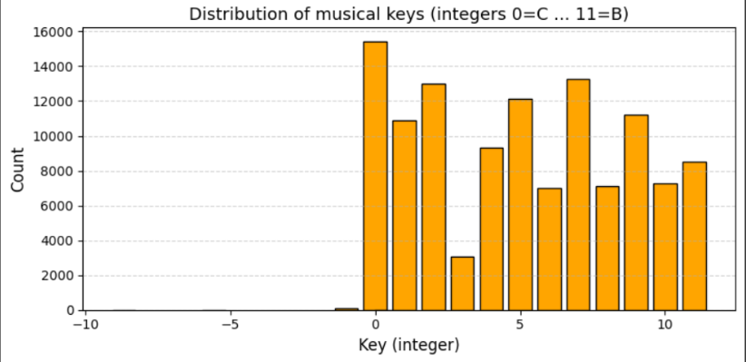
🎼 Distribution of Musical Keys — Spotify Tamil Dataset
🎹 Key Frequency Highlights:
Most common keys:
C (0) → 15,447 tracks
G (7) → 13,269 tracks
D (2) → 13,023 tracks
F (5) → 12,157 tracks
Least common: E♭ (3), F♯ (6), B (11) moderately lower usage
Rare outliers (negative keys) are data errors or non-standard tunings.
🎵 Interpretation:
The key distribution is well-balanced, but slightly favors C major, G major, and D major, which are bright, resonant keys ideal for pop and film-style production.
Keys with complex accidentals (like D♭ or G♭) are less common — likely due to instrument tuning and vocal comfort.
✨ Insight:
Tamil tracks prefer harmonically simple, uplifting keys (C, G, D, F), aligning with global pop composition trends that emphasize clarity, vocal range, and ease of instrumentation.

Slide 12
🎵 Spotify Tamil Dataset — Final Insights Summary
🎧 Audio Feature Insights:
High performers: Energy (0.60), Danceability (0.61), Tempo (~118 BPM)
Top hits: Loud (~–6 dB), rhythmic, and moderately acoustic (0.26 avg).
Popularity correlation: Strongest with energy (r = 0.15) and danceability (r = 0.04)
Hit threshold: Top 10% > 45 popularity points
🎛️ Clustering & Trends:
4 clusters found:
🎶 Energetic Pop (most popular)
🎹 Balanced Groove
🎤 Acoustic Low Energy
🎼 Experimental/Instrumental
Popularity peaked ~2010–2020; newer songs show rising energy and tempo.
🤖 Predictive Modeling (Random Forest):
Accuracy: 89.5% ROC AUC: 0.73
Most influential features: 1️⃣ Loudness 2️⃣ Duration 3️⃣ Tempo 4️⃣ Acousticness 5️⃣ Valence
Model insight: Production and rhythm dominate success more than lyrics or mode.
Key Takeaway:
Modern Tamil hits follow a global pop blueprint — energetic, danceable, 3–4 min songs mastered around –6 dB, blending rhythm, clarity, and emotional balance.

Slide 13
🎯 Conclusion — Spotify Tamil Music Analysis
Popularity: Most songs are moderately popular; only a few become major hits — showing a hit-driven market.
Musical Style: Songs mainly in C, G, D, and F keys, 4/4 rhythm, ~4 min long — matching global pop standards.
Sound Profile: Tamil tracks are energetic (0.62), danceable (0.63), and loud (~–7 dB) with low acousticness — a modern, electronic sound.
Correlations: Popularity rises with energy & danceability, falls with long or instrumental tracks.
Evolution (1970–2020): Energy and tempo have steadily grown, showing a shift from melodic to high-energy digital production.
Model Insights:
Accuracy: 89% | R²: 0.63
Top drivers: Loudness, Duration, Tempo, Acousticness, Valence
Confirms success depends on production quality & rhythm, not just melody.
✨ Final Takeaway:
Tamil music now blends local emotion with global energy — short, rhythmic, and powerfully produced songs dominate Spotify success.

